Slide 1
Overview
1
Register Transfer Language
Register Transfer
Bus and Memory Transfers
Arithmetic Micro-operations
Logic Micro-operations
Shift Micro-operations
Arithmetic Logic Shift Unit

Slide 2
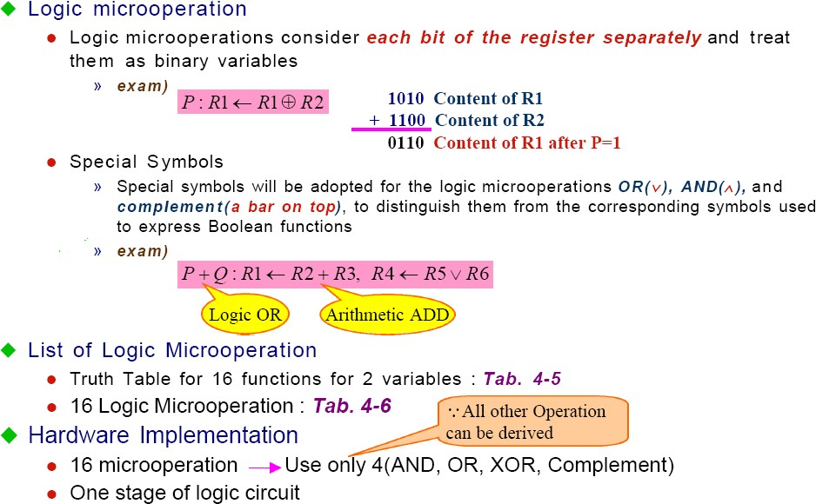
Logic Micro operations
2

Slide 3
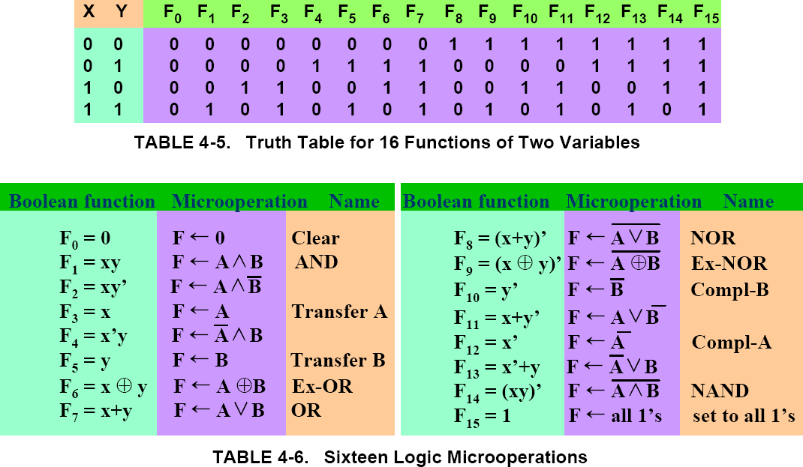
Logic Microoperations
3

Slide 4

Hardware Implementation
4
A_{i} B _{i}
0
1
4 X 1 _{F i} MUX
2
³ Select
S ₁
S ₀
Function table
S₁ | S₀ | Output | μ-operation
0 | 0 | F = A ∧ B | AND
0 | 1 | F = A ∨ B | OR
1 | 0 | F = A Ⓒ B | XOR
1 | 1 | F = A’ | Complement

Slide 5
Applications of Logic Microoperations
5
Logic microoperations can be used to manipulate individual bits or a portions of a word in a register
Consider the data in a register A. In another register, B, is bit data that will be used to modify the contents of A
Selective-set
Selective-complement
Selective-clear
Mask (Delete)
Clear
Insert
Compare
A ← A + B
A ← A Ⓒ B A ← A • B’ A ← A • B A ← A Ⓒ B
A ← (A • B) + C
A ← A Ⓒ B

Slide 6
6
Applications of Logic Microoperations
1. In a selective set operation, the bit pattern in B is used to set certain bits in A 1 1 0 0 A_{t} 1 0 1 0 B 1 1 1 0 A_{t+1} (A ← A + B) If a bit in B is set to 1, that same position in A gets set to 1, otherwise that
2. In^{bi}a^{t i}s^{n}el^{A}ec^{k}t^{e}iv^{e}e^{ps}co^{it}m^{s} pl^{r}e^{e}m^{vi}eºn^{u}t^{s} o^{v}p^{al}e^{u}r^{e}ation, the bit pattern in B is used to complement certain bits in A 1 1 0 0 A_{t} 1 0 1 0 B 0 1 1 0 A_{t+1} (A ← A Ⓒ B) If a bit in B is set to 1, that same position in A gets complemented from its original value, otherwise it is unchanged

Slide 7
7
Applications of Logic Microoperations
3. In a selective clear operation, the bit pattern in B is used to clear certain bits in A 1 1 0 0 A_{t} 1 0 1 0 B 0 1 0 0 A_{t+1} (A ← A ⋅ B’) If a bit in B is set to 1, that same position in A gets set to 0, otherwise it is unchanged
4. In a mask operation, the bit pattern in B is used to clear certain bits in A 1 1 0 0 A_{t} 1 0 1 0 B 1 0 0 0 A_{t+1} (A ← A ⋅ B) If a bit in B is set to 0, that same position in A gets set to 0, otherwise it is unchanged

Slide 8
Applications of Logic Microoperations
8
5. In a clear operation, if the bits in the same position in A and B are the same, they are cleared in A, otherwise they are set in A
1 1 0 0 A_{t}
1 0 1 0 B
0 1 1 0
^{A}t+1
(A ← A Ⓒ B)

Slide 9
Applications of Logic Microoperations
9
6. An insert operation is used to introduce a specific bit pattern into A register, leaving the other bit positions unchanged
This is done as
–
–
–
A mask operation to clear the desired bit positions, followed by
An OR operation to introduce the new bits into the desired positions Example
•
•
Suppose you wanted to introduce 1010 into the low order four bits of A: 1101 1000 1011 0001 A (Original)
1101 1000 1011 1010 |  |  | A (Desired)
• | 1101 1000 | 1011 | 0001 |  | A (Original)
 | 1111 | 1111 | 1111 | 0000 | Mask
 | 1101 | 1000 | 1011 | 0000 | A (Intermediate)
 | 0000 | 0000 | 0000 | 1010 | Added bits
 | 1101 | 1000 | 1011 | 1010 | A (Desired)

Slide 10
Shift Microoperations
10
•
There are three types of shifts
–
–
–
Logical shift Circular shift Arithmetic shift
•
What differentiates them is the information that goes into the serial input
A right shift operation
Serial
input
A left shift operation
Serial input

Slide 11
Logical Shift
11
•
In a logical shift the serial input to the shift is a 0.
•
A right logical shift operation:
0
•
A left logical shift operation:
0
•
In a Register Transfer Language, the following notation is used
–
–
–
shl shr
Examples:
for a logical shift left for a logical shift right
•
•
R2 ← shr R2 R3 ← shl R3

Slide 12
Circular Shift
12
•
In a circular shift the serial input is the bit that is shifted out of the other end of the register.
•
A right circular shift operation:
•
A left circular shift operation:
•
In a RTL, the following notation is used
–
–
–
cil cir
Examples:
for a circular shift left for a circular shift right
•
•
R2 ← cir R2 R3 ← cil R3

Slide 13

Arithmetic Shift
13
•
•
•
•
•
An arithmetic shift is meant for signed binary numbers (integer) An arithmetic left shift multiplies a signed number by two
An arithmetic right shift divides a signed number by two Sign bit : 0 for positive and 1 for negative
The main distinction of an arithmetic shift is that it must keep the sign of the number the same as it performs the multiplication or division
•
A right arithmetic shift operation:
sign bit
•
A left arithmetic shift operation:
0
sign bit

Slide 14

Arithmetic Shift
14
•
An left arithmetic shift operation must be checked for the overflow
0
sign bit
Before the shift, if the leftmost two bits differ, the shift will result in an overflow
V
In a RTL, the following notation is used
ashl
ashr
– Examples:
for an arithmetic shift left for an arithmetic shift right
» R2 ← ashr R2
» R3 ← ashl R3

Slide 15
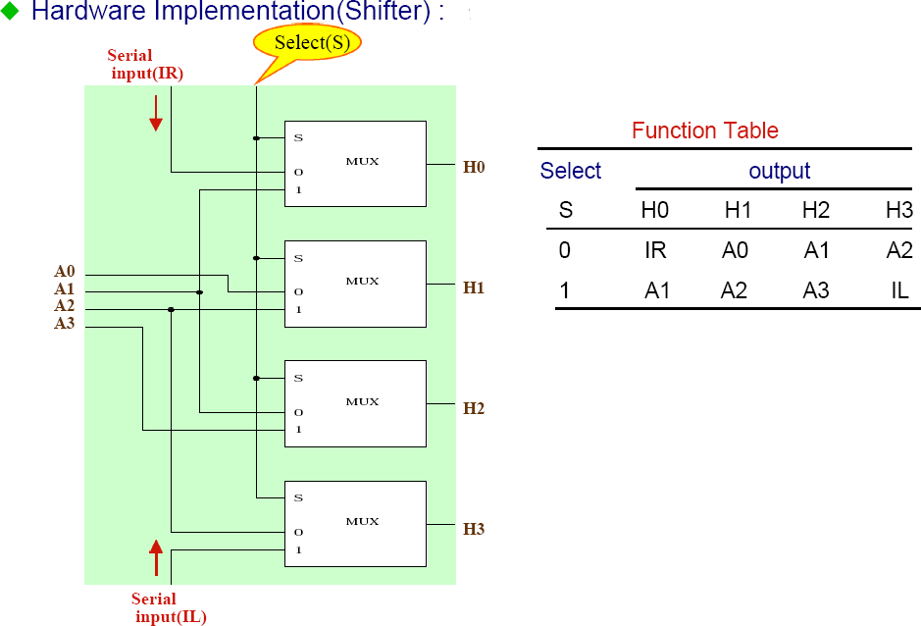
Hardware Implementation of Shift Microoperation
15

Slide 16
Arithmetic Logic and Shift Unit
16
S3 S2
S1
S0
C _{i}
Arithmetic Circuit
D _{i}
Select
0
1
2
3
4 x 1 _{F}
MUX
s2 | s3 | Operation
0 | 0 | Arithmetic
0 | 1 | Logical
1 | 0 | Shr
1 | 1 | shl
^{C} i+1
i
Logic Circuit
E
i
B _{i}
A
i
shr
^{A} i-1
shl
^{A} i+1

Slide 17
